Slide 1
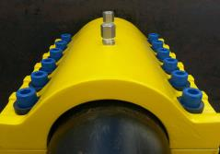
R&D Tax Incentive - What is in it for advanced manufacturing?
30th March 2016
Dr Greg Thomas
Assistant State Manager
AusIndustry - Business Services

Slide 2
R&D Tax Incentive
Programme Overview
A broad-based, market-driven, self assessment program.
An entitlement program – not a grant.
Controlled by legislation*.
Aimed at encouraging more businesses to carry out R&D.
Generous support, especially for small and medium-sized firms.
Jointly administered by AusIndustry and ATO.
* Industry Research and Development Act 1986 (Cth)
Division 355 – Income Tax Assessment Act 1997 (Cth)

Slide 3
R&D Tax Incentive
Benefits
Turnover of less than $20m turnover
45% refundable tax offset.
Turnover of equal or greater than $20m turnover
40% non-refundable tax offset.
Effective as of 1 July 2014, a $100m threshold applies to R&D expenditure

Slide 4
Programme Demographics 2013-14 (National)
R&D Tax Incentive – who’s accessing the programme
From a business perspective:
More than 13,600 companies* registered for 2013-14 income year.
Registrations up 14.6% year-on-year; number of companies up 17.7%.
Around 3,300 (24.3 %) new customers - up 10% up year-on-year.
Over 850 Advance/Overseas finding applications received to date.
Over 190 registered Research Service Providers (RSPs).
Total government support ~$2.97 billion in 2013-14 (Science, Research and Innovation Budget Tables, Sep 2014).
source: Department of Industry and Science (income year 2013-14, as at 31 December 2014) * for the R&D Tax Incentive, this includes R&D-performing subsidiaries of groups that are consolidated for tax purposes

Slide 5
Programme Demographics 2013-14 (WA)
R&D Tax Incentive – who’s accessing the programme
Western Australia’s participation:
More than 1,800 companies* registered for 2013-14 income year.
Number of companies up 13.5% year-on-year.
Around 430 (23.9%) new customers.
More than 60 Advance/Overseas finding applications received to date.
source: Department of Industry and Science (income year 2013-14, as at 31 December 2014) * for the R&D Tax Incentive, this includes R&D-performing subsidiaries of groups that are consolidated for tax purposes

Slide 6
R&D Tax Incentive
Eligibility Criteria
Eligible entity.
Undertake eligible R&D activities.
Minimum $20,000 expenditure p.a.
Good planning and record keeping.

Slide 7
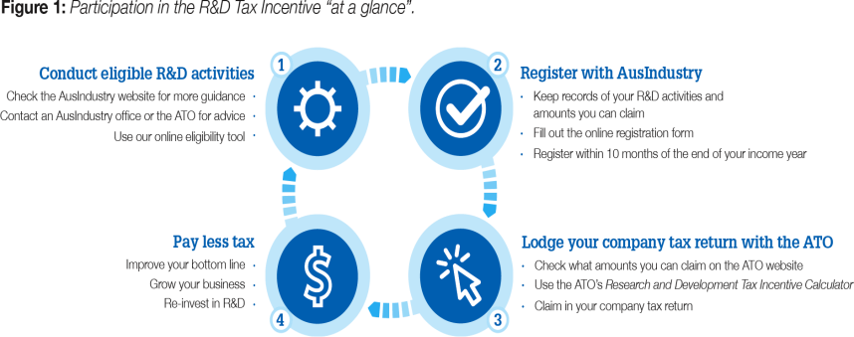
R&D Tax Incentive
How does the R&D Tax Incentive work?

Slide 8
R&D Tax Incentive
Specific issues Advanced Manufacturing Companies will
need to consider
All design and construction will involve some known engineering challenges that uses existing knowledge to solve a problem.
Company will need to explain why it was not able to reply on existing knowledge and was required to undertake an experiment to generate new knowledge.
Registration must be at R&D activity level and not at a project level.
.

Slide 9
R&D Tax Incentive
Specific issues Advanced Manufacturing Companies will
need to Consider
Research carried out under contract
Applicant must hold the purpose of generating new knowledge.
Purpose of generating new knowledge must be significant or substantial.
Applicant must bear the financial risk of the R&D activities it conducts.
Refer to JLSP versus Innovation Australia [2016] AATA 23. 22 January 2016.
.

Slide 10
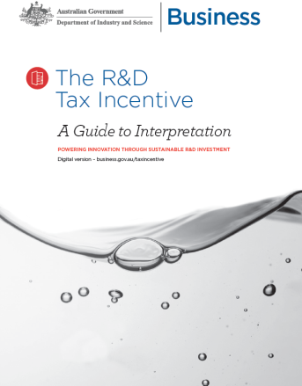
R&D Tax Incentive
AusIndustry Guidance Products - A Guide to Interpretation
AusIndustry has recently released a new Guide to Interpretation.
The Guide sets out how key elements of the definition of ‘R&D activities’ are interpreted.
It is designed to assist companies of all sizes, across all sectors, to understand and assess whether their work is eligible for the R&D Tax Incentive.

Slide 11
Programme Administration
Questions on:
Registration & eligibility of R&D activities
Questions on:
Eligible entities & amounts you can claim
13 28 46
rdtaxincentive@industry.gov.au
www.business.gov.au
13 28 66
www.ato.gov.au

